Slide 1


Slide 2

PROJECT TEAM
PERFORMANCE APPRAISAL
Notes:
The incidence of both lower incomes due to economic crisis and persistent high food prices has proved to be a devastating combination for the world’s most vulnerable populations.

Slide 3
Comparing Performance Appraisal and Performance Management
Performance appraisal
  Evaluating an employee’s current and/or past performance relative to his or her performance standards/ evaluation criteria.
Performance management
  The process employers use to make sure employees are working toward organizational goals.
  A process that consolidates goal setting, performance appraisal, & development into a single common system, the aim of which is to ensure that employees’ performance is supporting company’s strategic aims.

Slide 4
Why Performance Management?
Increasing use by employers of performance management reflects:
  The popularity of the total quality management (TQM) concepts.
  The belief that traditional performance appraisals are often not just useless but counterproductive.
  The necessity in today’s globally competitive industrial environment for every employee’s efforts to focus on helping the company to achieve its strategic goals.

Slide 5
An Introduction to Appraising
Performance
Why appraise performance?
  Appraisals play an integral role in the employer’s performance management process.
  Appraisals help in planning for correcting deficiencies and reinforce things done correctly.
  Appraisals, in identifying employee strengths and weaknesses, are useful for career planning
  Appraisals affect the employer’s salary raise decisions.

Slide 6
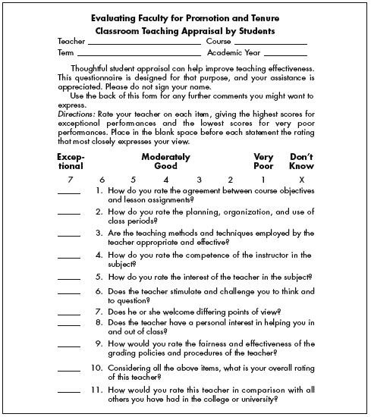
Classroom Teaching Appraisal By Students

Slide 7
Defining Goals and Work Efforts
Guidelines for effective goals
  Assign specific goals
  Assign measurable goals
  Assign challenging but doable goals
  Encourage participation
SMART goals are:
  Specific, and clearly state the desired results.
  Measurable in answering “how much.”
  Attainable, and not too tough or too easy.
  Relevant to what’s to be achieved.
  Timely in reflecting deadlines and milestones.

Slide 8
Performance Appraisal Roles
Supervisors
  Usually do the actual appraising.
  Must be familiar with basic appraisal techniques.
  Must understand and avoid problems that can cripple appraisals.
  Must know how to conduct appraisals fairly.

Slide 9
Performance Appraisal Roles
HR department
  Serves a policy-making and advisory role.
  Provides advice and assistance regarding the appraisal tool to use.
  Prepares forms and procedures and insists that all departments use them.
  Responsible for training supervisors to improve their appraisal skills.
  Responsible for monitoring the system to ensure that appraisal formats and criteria comply with EEO laws and are up to date.

Slide 10
Steps in Appraising Performance
Defining the job
  Making sure that you and your subordinate agree on his or her duties and job standards.
Periodic reviews
  Planned periodic reviews to ensure smooth sailing.
Appraising performance
  Comparing your subordinate’s actual performance to the standards that have been set; this usually involves some type of rating form.
Providing feedback
  Discussing the subordinate’s performance & progress and making plans for any development required.

Slide 11
Designing the Appraisal Tool
What to measure?
  Work output (quality and quantity)
  Personal competencies
  Goal (objective) achievement
How to measure?
  Essay method
  Graphic rating scales
  Alternation ranking method
  MBO
9–<number>

Slide 12
Performance Appraisal Methods
Graphic rating scale
  A scale that lists a number of traits and a range of performance for each that is used to identify the score that best describes an employee’s level of performance for each trait.

Slide 13
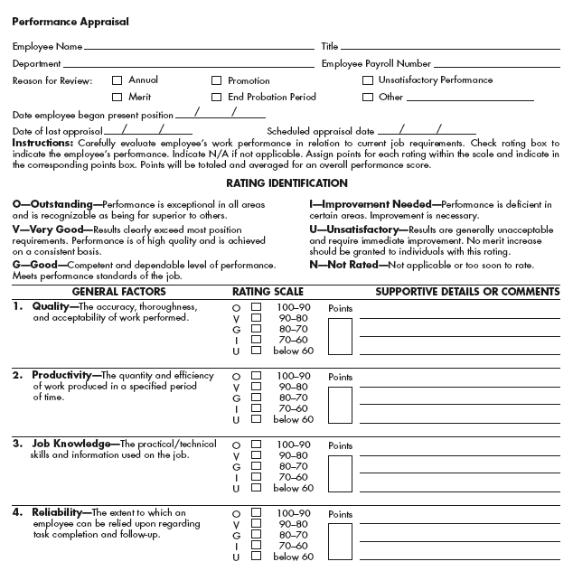
Graphic Rating Scale with Space for Comments

Slide 14
Performance Appraisal Methods
Alternation ranking method
  Ranking employees from best to worst on a particular trait, choosing highest, then lowest, until all are ranked.
Paired comparison method
  Ranking employees by making a chart of all possible pairs of the employees for each trait and indicating which is the better employee of the pair.

Slide 15
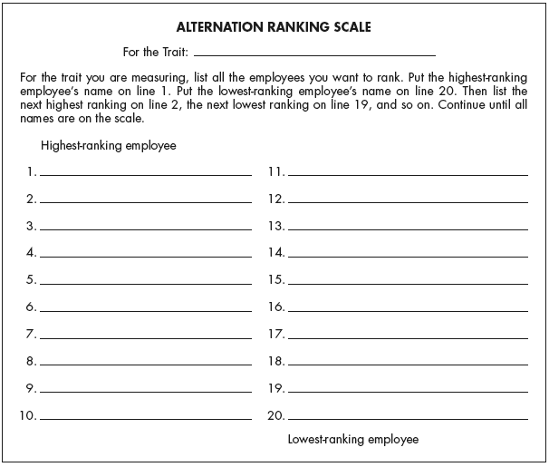
Alternation Ranking Scale

Slide 16
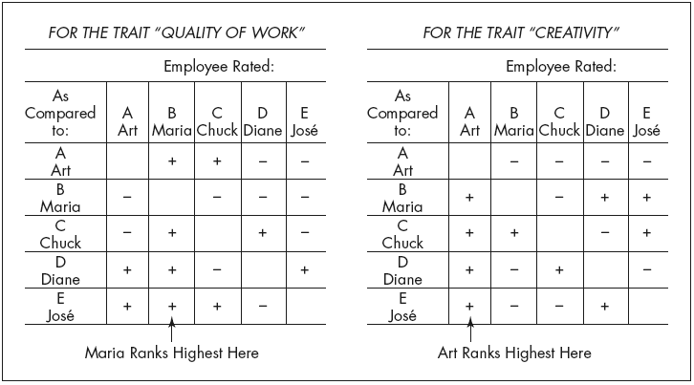
Ranking Employees by the
Paired Comparison Method
Note: + means “better than.” − means “worse than.” For each chart, add up the number of 1’s in each column to get the highest-ranked employee.

Slide 17
Performance Appraisal Methods
Forced distribution method
  Similar to grading on a curve; predetermined percentages of ratees are placed in various performance categories.
  Example:
    15% high performers
    20% high-average performers
    30% average performers
    20% low-average performers
    15% low performers
Narrative Forms
A narrative of critical events is maintained & periodically reviewed, during formal meetings with employees.

Slide 18
Performance Appraisal Methods
Behaviorally anchored rating scale (BARS)
  An appraisal method that uses quantified scale with specific narrative examples of good and poor performance.
Developing a BARS:
  Generate critical incidents
  Develop performance dimensions
  Reallocate incidents
  Scale the incidents
  Develop a final instrument

Slide 19
Performance Appraisal Methods
Advantages of using a BARS
  A more accurate gauge
  Clearer standards
  Feedback
  Independent dimensions
  Consistency

Slide 20
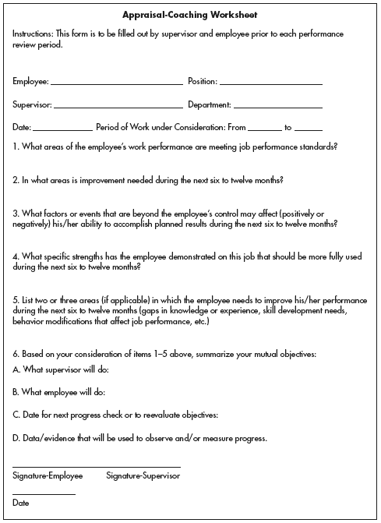
Appraisal-Coaching Worksheet

Slide 21
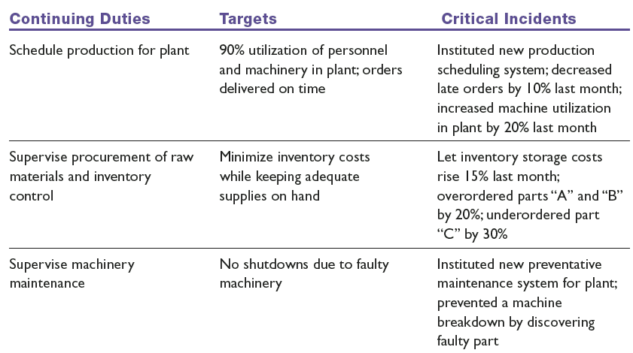
Examples of Critical Incidents for an Assistant Plant Manager

Slide 22
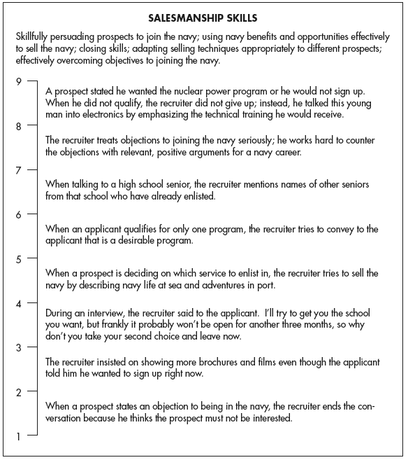
Example of a Behaviorally Anchored Rating Scale for the Dimension Salesmanship Skill

Slide 23
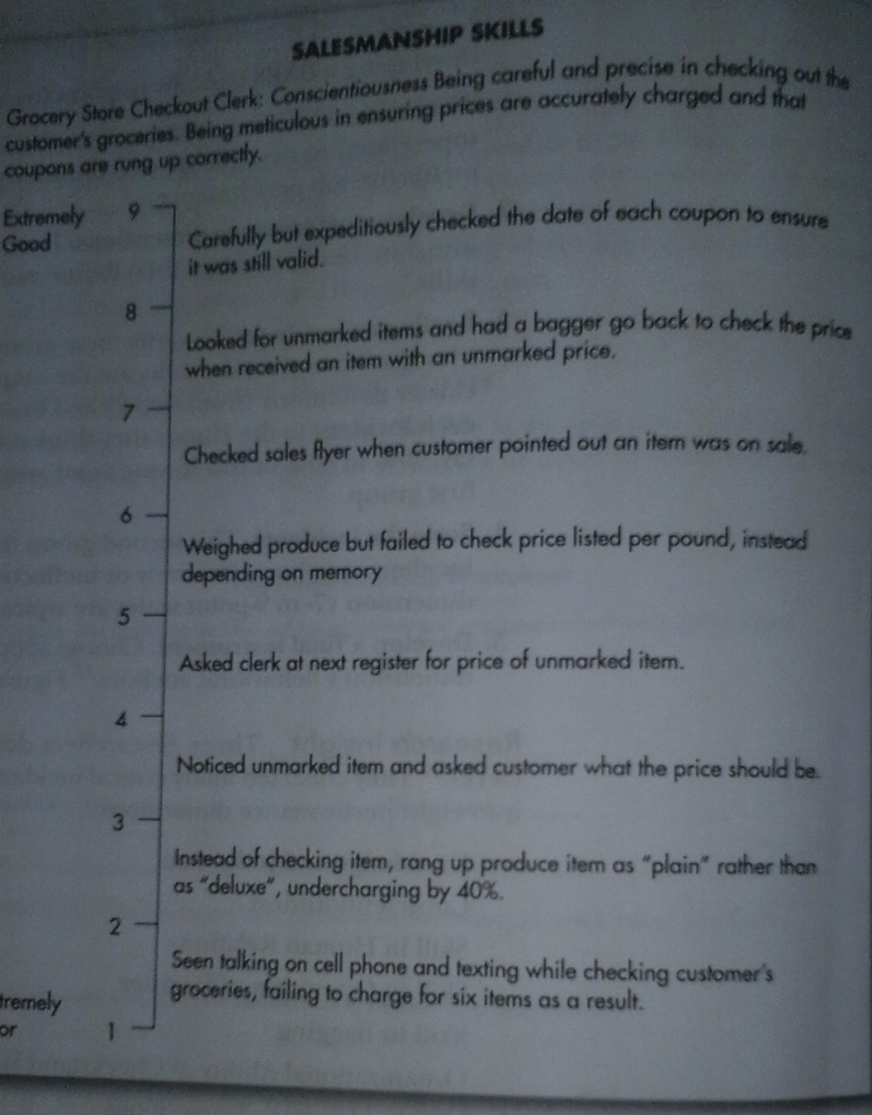

Slide 24
Management by Objectives (MBO)
Involves setting specific measurable goals with each employee and then periodically reviewing the progress made.
    Set the organization’s goals.
    Set departmental goals.
    Discuss departmental goals.
    Define expected results (set individual goals).
    Performance reviews.
    Provide feedback.

Slide 25
Computerized and Web-Based Performance Appraisal
Performance appraisal software programs
  Keep notes on subordinates during the year.
  Electronically rate employees on a series of performance traits.
  Generate written text to support each part of the appraisal.
Electronic performance monitoring (EPM)
  Having supervisors electronically monitor the amount of computerized data an employee is processing per day, and thereby his or her performance.

Slide 26
Potential Rating Scale Appraisal Problems
Unclear standards
  An appraisal that is too open to interpretation.
Halo & Horn effect
  Occurs when a supervisor’s rating of a subordinate on one trait biases the rating of that person on other traits.
Central tendency
  A tendency to rate all employees the same way, such as rating them all average.

Slide 27
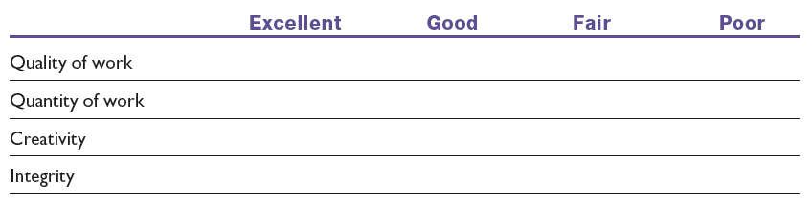
A Graphic Rating Scale with Unclear Standards
Note: For example, what exactly is meant by “good,” “quantity of work,” and so forth?

Slide 28
Potential Rating Scale Appraisal Problems
Strictness/leniency
  The problem that occurs when a supervisor has a tendency to rate all subordinates either high or low.
Bias
  The tendency to allow individual differences such as age, race, and sex to affect the appraisal ratings employees receive.

Slide 29
How to Avoid Appraisal Problems
Learn and understand the potential problems, and the solutions for each.
Use the right appraisal tool. Each tool has its own pros and cons.
Train supervisors to reduce rating errors such as halo, leniency, and central tendency.
Have raters compile positive and negative critical incidents as they occur.

Slide 30
Who Should Do the Appraising?
The immediate supervisor
Peers
Rating committees
Self-ratings
Subordinates
360-Degree feedback

Slide 31
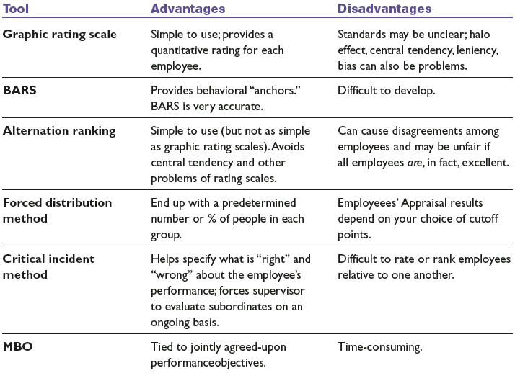
Advantages and Disadvantages of Appraisal Tools

Slide 32
The Appraisal Interview
Types of appraisal interviews
  Satisfactory—Promotable
  Satisfactory—Not promotable
  Unsatisfactory—Correctable
  Unsatisfactory—Uncorrectable
How to conduct the appraisal interview
  Talk in terms of objective work data.
  Don’t get personal.
  Encourage the person to talk.
  Don’t tiptoe around.

Slide 33
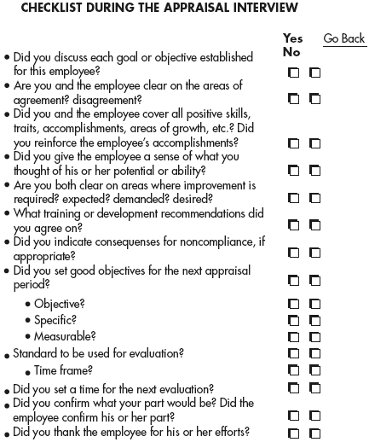
Checklist During the Appraisal Interview

Slide 34
The Appraisal Interview
How to handle a defensive subordinate
  Recognize that defensive behavior is normal.
  Never attack a person’s defenses.
  Postpone action.
  Recognize your own limitations.

Slide 35
The Appraisal Interview
How to criticize a subordinate
  Do it in a manner that lets the person maintain his or her dignity and sense of worth.
  Criticize in private, and do it constructively.
  Avoid once-a-year “critical broadsides” by giving feedback on a daily basis, so that the formal review contains no surprises.
  Never say the person is “always” wrong
  Criticism should be objective and free of any personal biases on your part.

Slide 36
The Appraisal Interview
How to ensure the interview leads to improved performance
  Don’t make the subordinate feel threatened during the interview.
  Give the subordinate the opportunity to present his or her ideas and feelings and to influence the course of the interview.
  Have a helpful and constructive supervisor conduct the interview.
  Offer the subordinate the necessary support for development and change.

Slide 37
The Appraisal Interview
How to handle a formal written warning
  Purposes of the written warning
    To shake your employee out of bad habits.
    Help you defend your rating, both to your own boss and (if needed) to the courts.
  Written warnings should:
    Identify standards by which employee is judged.
    Make clear that employee was aware of the standard.
    Specify deficiencies relative to the standard.
    Indicate employee’s prior opportunity for correction.

Slide 38
Thank You

